Slide 1
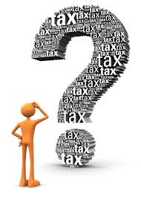
“In this world nothing can be said to be certain, except death and taxes.” Benjamin Franklin
Tax is a mandatory liability for every citizen of the country. There are two types of tax in India
i.e. Direct and Indirect.
Taxation in India is rooted from the ancient period. Present Indian tax system is based on this ancient tax system which was based on the theory of maximum social welfare.

Slide 2
Brief History of Income Tax in India
In India, this tax was introduced for the first time in 1860, by Sir James Wilson in order to meet the losses sustained by the Government on account of the Military Mutiny of 1857.
In 1918, a new income tax was passed and again it was replaced by another new act which was passed in 1922.This Act remained in force up to the assessment year 1961-62 with numerous amendments.
In consultation with the Ministry of Law finally the Income Tax Act, 1961 was passed. The Income Tax Act 1961 has been brought into force with 1 April 1962. It applies to the whole of India and Sikkim (including Jammu and Kashmir).
Since 1962 several amendments of far-reaching nature have been made in the Income Tax Act by the Union Budget every year.

Slide 3










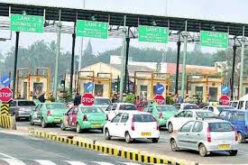


Paying tax almost everywhere!!!

Slide 4

Why should I pay tax?
I have to pay for my food, for my house, for my travel, for my medical treatment, for owning a vehicle not only cost of vehicle but also vehicle tax and what not.
Even on many roads, one has to pay toll tax! They also say that if we compare with countries like USA and UK, the people get social security as also medical facilities virtually without any cost. But India does not offer such facilities.

Slide 5
What Government Do from our TAX?
The Government provide Health care through Government hospitals (usually they offer service without any cost), Education (In Municipal and Government schools the fee is negligible).
Of course the major expenditure of Government has to be incurred on National Defense, Infrastructure Developments etc.
Taxes are used by the government for carrying out various welfare schemes including employment programs.
There are Lakhs of employees in various departments and the administrative cost has to be borne by the Government.

Slide 6
What Government Do from our TAX?
On judicial system: the Salaries, perks of Judges, Magistrates and judicial staff has also to be paid by the Government.
PM Kisan yojana: Government started giving Rs 6000 per year to farmers.
The Government also provides cooking gas at concessional rate or gives subsidy.
Government also provide support to MSMEs and small business in terms of subsidies.
Thus on considering these various duties of the Government, we need to appreciate that we must pay tax as per law. We have to act like a responsible citizen.

Slide 7

Personal Taxation

Slide 8
TAX SLAB: INDIVIDUAL (MALE/FEMALE) BELOW 60 YEARS
Income | Tax rate
Income upto Rs. 2,50,000/- | NIL
Income from Rs. 2,50,001/- to Rs. 5,00,000/- | 5%
Income from Rs. 5,00,001/- to Rs. 10,00,000/- | 20%
Above Rs. 10,00,000/- | 30%

Slide 9
TAX SLAB: INDIVIDUAL (MALE/FEMALE) 60 YEARS OF AGE OR MORE BUT BELOW 80 YEARS
Income | Tax rate
Income upto Rs. 3,00,000/- | NIL
Income from Rs. 3,00,001/- to Rs. 5,00,000/- | 5%
Income from Rs. 5,00,001/- to Rs. 10,00,000/- | 20%
Above Rs. 10,00,000/- | 30%

Slide 10
TAX SLAB: INDIVIDUAL (MALE/FEMALE) 80 YEARS AND ABOVE
Income | Tax rate
Income upto Rs. 5,00,000/- | NIL
Income from Rs. 5,00,001/- to Rs. 10,00,000/- | 20%
Above Rs. 10,00,000/- | 30%

Slide 11
SURCHARGE
Income | Rate
Income of Rs. 50 Lakhs > Rs. 1 Crore (including CG u/s. 111A &112A) | 10%
Income of Rs. 1 Crore > Rs. 2 Crore (including CG u/s. 111A &112A) | 15%
Income of Rs. 2 Crores > Rs. 5 Crores (Excluding CG u/s. 111A &112A) | 25%
Income of Rs. 5 Crores > (Excluding CG u/s. 111A &112A) | 37%
Income of Rs. 2 Crore > (including CG u/s. 111A &112A) | 15%

Slide 12

EFFECTIVE RATE
Income | Rate
Income of Rs. 50 Lakhs > Rs. 1 Crore (including CG u/s. 111A &112A) | 34.32%
Income of Rs. 1 Crore > Rs. 2 Crore (including CG u/s. 111A &112A) | 35.88%
Income of Rs. 2 Crores > Rs. 5 Crores (Excluding CG u/s. 111A &112A) | 39.00%
Income of Rs. 5 Crores > (Excluding CG u/s. 111A &112A) | 42.74%
Income of Rs. 2 Crore > (including CG u/s. 111A &112A) | 35.88%

Slide 13
Section 115BAC- Tax on income of Individuals and Hindu Undivided family
Sl. No. | Total Income | Rate of tax
(1) | (2) | (3)
1. | Upto Rs 2,50,000 | Nil
2. | From Rs 2,50,001 to Rs 5,00,000 | 5 per cent.
3. | From Rs 5,00,001 to Rs 7,50,000 | 10 per cent.
4. | From Rs 7,50,001 to Rs 10,00,000 | 15 per cent.
5. | From Rs 10,00,001 to Rs 12,50,000 | 20 per cent.
6. | From Rs 12,50,001 to Rs 15,00,000 | 25 per cent.
7. | Above Rs 15,00,000 | 30 per cent.:

Slide 14
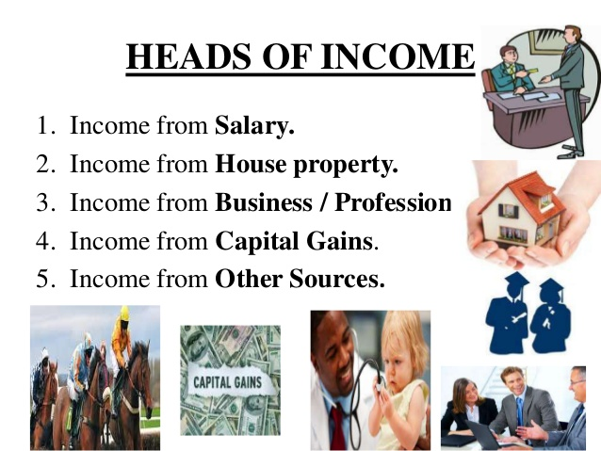
Heads of Income
Income from Salary
Income from house property
Income from business / Profession
Income form Capital Gain
Income from other sources.

Slide 15

Important Terminologies
Assessee
– Section 2(7) of Income Tax.
As per S. 2(7) of the Income Tax Act, 1961, unless the context otherwise requires, the term “assessee” means a person by whom any tax or any other sum of money is payable under this Act, and includes
Person in respect of whom any proceedings under this Act has been taken for assessment of his income
Deemed assessee under provisions of this Act
Any person deemed to be an assesse in default under any provisions of this Act.

Slide 16
Important Terminologies
Assessment Year (A.Y. 2022‐23)
Assessment year means the period starting from April 1 and ending on March 31 of the next year.
Previous Year (F.Y. 2021‐22)
The financial year immediately preceding the assessment year

Slide 17
Important Terminologies
Residential Status
Resident – World income is taxable in India
Non Resident(NRI) – Only income arising or accruing in India is taxable in India
Resident but Not Ordinarily Resident – Income accruing or arising outside India may also be taxable in India
Resident: On basis of stay in India computed separately every year
If satisfies any of the below condition:
1. He is in India for a period of 182 days or more in the FY
OR
2. He is in India for 60 days or more during that FY and has been in India for 365 days or more during 4 previous years immediately preceding the relevant Financial Year.

Slide 18
Important Terminologies
Gross Total Income
Deductions
Total Income

Slide 19
HEADS OF INCOME
Income From Salary
Meaning of Salary:
Wages
Pension
Annuity
Gratuity
Advance Salary paid
Fees, Commission, Perquisites, Profits in lieu of or in addition to Salary or Wages
Annual accretion to the balance of Recognized Provident Fund
Leave Encashment
Transferred balance in Recognized Provident Fund
Contribution by Central Govt. or any other employer to Employees Pension A/c as referred in Sec. 80CCD.

Slide 20
Income From Salary
1. CTC
2. Gross Salary
-is employee provident fund (EPF) and gratuity subtracted from the Cost to Company (CTC). To put it in simpler terms, Gross Salary is the amount paid before deduction of taxes or other deductions and is inclusive of bonuses, over-time pay, holiday pay, and other differentials.
For the same example listed above, let’s deduce Mr. A yearly salary by subtracting gratuity and Employee Provident Fund contributions.
Rs. 4,00,000 - Rs. 21,600 - Rs. 18,326
= Rs. 3,60,074

Slide 21
Income From Salary
Particulars | Amount
Basic Salary | —
Add: | —
1. Fees, Commission and Bonus | —
2. Allowances | —
3. Perquisites | —
4. Retirement Benefits | —
5. Fees, Commission and Bonus | —
Gross Salary | —
Less: Deductions from Salary | —
1. Entertainment Allowance u/s 16 | —
2. Professional Tax u/s 16 | —
Net Salary | —

Slide 22
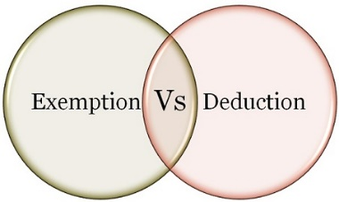
Income From Salary
Deduction/Exemption
What is the difference between Exemption and deduction?
If an income is exempt from tax, then it is not included in the computation of income. However, the deduction is given from income chargeable to tax. Exempt income will never exceed the amount of income. However, the deduct may be less than or equal to or more than the amount of income.
Exemption: Section 10 deals with exemptions
Deduction: Section 80 C to 80 U deals with deduction

Slide 23
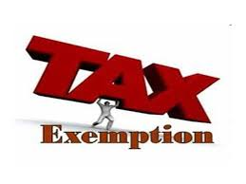
Income From Salary
Exemption
Section 10(1) to Section 10(38) Deals with exempt Income
Section 10(5)-Leave Travel Allowance
The bills for your travel against LTA can be claimed for exemption. It is allowed to be claimed twice in a block of four years. The current block is 2018 to 2022.
Exempt from tax in the hands of employee as per following.
If journey by Air –Economy class fare of the national carrier( Air India) by shortest route or the amount spent whichever is less.
If journey by Rail – AC First class fare by shortest route or the amount spent whichever is less
Where places of origin of Journey and destination are connected by rail & journey is performed by any other mode of transport- AC First class fare by shortest route or the amount spent whichever is less.
Where places of origin of Journey and destination are not connected by rail,
a) Recognized public transport exists- First class or deluxe class fare by the shortest route or the amount spent, whichever is less.
b) No recognized public transport exists - AC First class rail fare by Shortest route or the amount spent whichever is less

Slide 24
Income From Salary
Exemption
Section 10(1) to Section 10(38) Deals with exempt Income
Section 10(5)-Leave Travel Allowance Conditions:
LTA should be uniform to all the employees
Employers need to collect and scrutinize the proof of travel (ticket etc.)
Limited to the actual expenses incurred
Any Leave encashed for the purpose of Leave travel or home travel concession is taxable.
Foreign Travel – The exemption is not available in case of Foreign Travel
The Exemption is not available to more than 2 surviving children of an individual born after 1.10.1998. However, this restriction is not there in respect of children born before 1.10.1998.

Slide 25
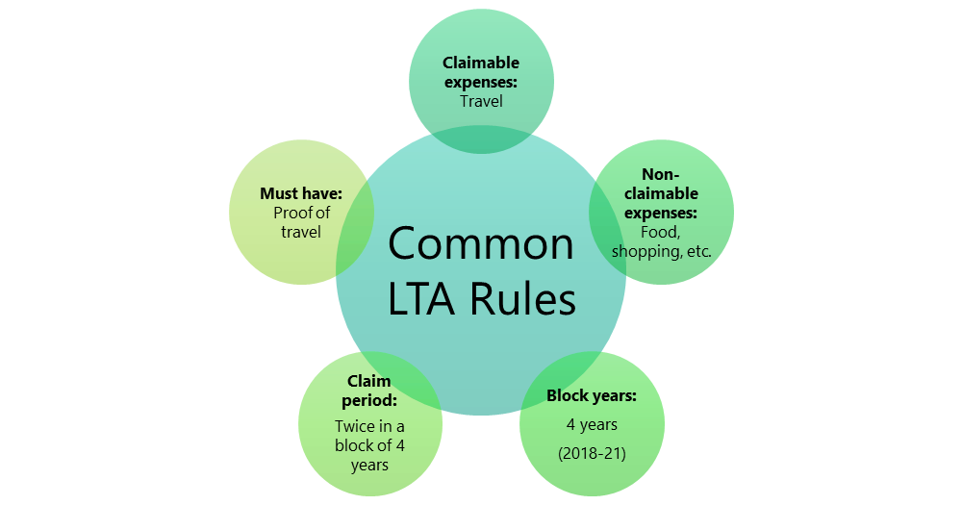
Income From Salary
Exemption
Section 10(5)-Leave Travel Allowance

Slide 26
Income From Salary
Exemption
Section 10(13A): House Rent Allowance(HRA)
This is the famous exemption which is used by many salaried individuals. However, the wrong belief is that whatever the rent they pay is actually exempted from their income. The reality is different. The amount of exemption is least of the following.
a) Actual HRA Received
b) 40% of Salary (50%, if house situated in Metro Region)
c) Rent paid minus 10% of salary
(Salary = Basic + DA (if part of retirement benefit) + Turnover based Commission)

Slide 27

Section 10(13A): House Rent Allowance(HRA)
Employee No - 1234 | Name - ABC
Joining Date - 01/01/2011 | PF No - SB/AYE/1234567/123/1234567
BASIC | 30,000 | PF | 2,000
HRA | 13,000 | Professional Tax | 200
CONVEYANCE | 2,000
SPECIAL ALLOWANCE | 3,000
MEDICAL | 1,250
LTA | 5,000
Total Earnings | 54,250
Salary ( considering no commission & DA) | 30,000*12=3,60,000/-
10% of Basic Salary | 3,60,000*10%=36,000/-
Rent Paid per month | 10,000/-
Particulars | Calculation | Amount(INR)
a)Actual HRA Received | 13,000*12 | 1,56,000/-
b) 50% of Salary | 3,60,000*50% | 1,80,000 /-
c)Rent paid (-)10% of salary | (10,000*12)-36,000/- | 84,000/-
Exemption Which ever is less(a,b,c) |  | 84,000/-

Slide 28
Income From Salary
Exemption
Allowances Exempt under Section 10(14)(I)-No limit
Travelling Allowance
Daily Allowance
Conveyance Allowance:-This is the different allowance than transport allowance. It is the expenditure granted to an employee to meet the expenses on conveyance in performing of his office duties.
Helper Allowance
Academic Allowance:- Allowance granted for encouraging academic, research & training pursuits in educational & research Institutional.
Uniform allowance

Slide 29
Income From Salary
Exemption
Standard deduction of Rs. 50,000
Particulars | Until AY 2018-19 | From AY 2021-22
Gross Salary (in Rs.) | 5,00, 000 | 5,00,000
(-) Transport Allowance | 19,200 | Not Applicable
(-) Medical Allowance | 15,000 | Not Applicable
(-) Standard Deduction | Not Applicable | 50,000
Net Salary | 4,65,800 | 4,50,000

Slide 30
Income From Salary
Exemption
Deduction U/s (16)
There are basically two deduction
1.) Entertainment Allowance [Section 16(ii)] -(Government Employees)
2.) Professional Tax [Section 16(iii)] -(2,500/-)

Slide 31

Income from House Property
Particulars | Amount (Rs.)
Gross Annual Value | xxx
Less: Municipal taxes | (xxx)
Net Annual Value | xxx
Less: Deductions u/s 24 Standard deduction Deduction on interest paid | (xxx) (xxx)
Taxable income from house property
Deductions:
Standard Deduction u/s 24@30% of Annual Value
Interest paid on home loan ( Max Rs. 200,000/-)
Loan Principle payment u/s 80C
Deduction for fist time home buyer u/s 80EE

Slide 32
Income from House Property
Deduction for fist time home buyer u/s 80EE
First time Home Buyers can claim an additional Tax deduction of up to Rs.50,000 on home loan interest payments under this section. Below are the few conditions for this.
He must be an individual (Resident or Non-Resident).
Loan must be taken for the acquisition of the property.
Loan should be sanctioned after 2016-17.
Loan amount should not exceed Rs. 35 Lakh.
The value of the house should not be more than Rs 50 Lakh.
The home buyer should not have any other existing residential house during the sanction of loan.
Do remember that if you claimed the interest under this section, then the same can’t be claimed under other sections for deductions.

Slide 33

Income from Other Sources
Income:
Dividend
Interest- From Savings, Term deposit, income tax refund, other
Income of winnings from lotteries, crossword puzzles etc., excluding income from owning race horses
Income from the activity of owning and maintaining race horses

Slide 34
Income from Other Sources
DEDUCTIONS
Deduction on Interest Income Under Section 80TTA
For a residential individual (age of 60 years or less) or HUF, interest earned upto Rs 10,000 in a financial year is exempt from tax. The deduction is allowed on interest income earned from:
savings account with a bank
savings account with a co-operative society carrying on the business of banking
savings account with a post office
Senior citizens are not entitled to benefits under section 80TTA.
Interest income in case of Fixed Deposit (PAN)
Tax on Fixed Deposits
Senior citizens, with effect from 1 April 2018, will enjoy an income tax exemption up to Rs. 50,000/- on the interest income they receive from fixed deposits with banks, post offices etc. under Section 80TTB.

Slide 35
Income from Other Sources
DEDUCTIONS
Exempt Income
The PPF and EPF amount you withdraw after maturity is exempt from tax and must be declared as exempt income from income from other sources.
Note that: The EPF is only tax exempt after five years of continuous service.
Family Pension
If you are collecting pension on behalf of someone who is deceased, then you must show this income under income from other sources. There is a deduction of Rs 15,000 or one-third of the family pension received whichever is lower from the Family Pension Income. This will be added to the taxpayer’s income and tax must be paid at the tax rate that is applicable.
Taxation of Winnings from Lottery, Game Shows, Puzzles
If you receive money from winning the lottery, Online/TV game shows etc., it will be taxable under the head Income from other Sources. The income will be taxable at the flat rate of 30% which after adding cess will amount to 30.9%

Slide 36

Deductions under Chapter VI-A
Section 80C
Maximum Limit- Rs.1,50,000/-
You can save tax on salary income from this section alone
Different Investment in this section includes
Life Insurance premium (Paid by an individual, spouse, and child. In the case of HUF, on the life of any member of HUF).
EPF-Employee contribution can be claimed for deduction.
Public Provident Fund (Paid by an individual, spouse, and child. In the case of HUF, on the life of any member of HUF).
National Savings Certificate (NSC).
Sukanya Samriddhi Account
ELSS or Tax Saving Mutual Funds
Senior Citizen Savings Scheme
5-Years Post Office or Bank Deposits.
Tuition fee of kids.
Principal payment towards home loan.
Stamp duty and registration cost of the house.

Slide 37
Deductions under Chapter VI-A
Section 80CCC
Deduction under Sec.80CCC is available only for individuals. Contribution to an annuity plan of the LIC of India or any other insurer for receiving the pension. Do remember that the amount should be paid or deposited out of income chargeable to tax.
Note:- this is also the part of the combined limit of Rs.1.5 lakh available under Sec.80C Sec.80CCC, and Sec.80CCD(1)

Slide 38
Deductions under Chapter VI-A
NPS Tax Benefit-Section 80CCD1
An individual’s maximum 20% of annual income (Earlier it was 10% but after Budget 2017, it increased to 20%) or an employees (10% of Basic+DA) contribution will be eligible for deduction.
Note:- this is also the part of the combined limit of Rs.1.5 lakh available under Sec.80C Sec.80CCC, and Sec.80CCD(1)
NPS Tax Benefit-Section 80CCD2
There is a misconception among many that there is no upper limit for this section. However, the limit is least of 3 conditions.
1) Amount contributed by an employer,
2) 10% of Basic+DA and
3) Gross Total Income.
This is additional deduction which will not form the part of Sec.80C limit.
The deduction under this section will not be eligible for self-employed.

Slide 39
Deductions under Chapter VI-A
NPS Tax Benefit-Section 80CCD(1B)
This is the additional tax benefit of up to Rs.50,000 eligible for income tax deduction and was introduced in the Budget 2015, One can avail the benefit of this Sect.80CCD (1B) from FY 2015-16.
Both self-employed and employees are eligible for availing this deduction.
This is over and above Sec.80CCD (1).

Slide 40
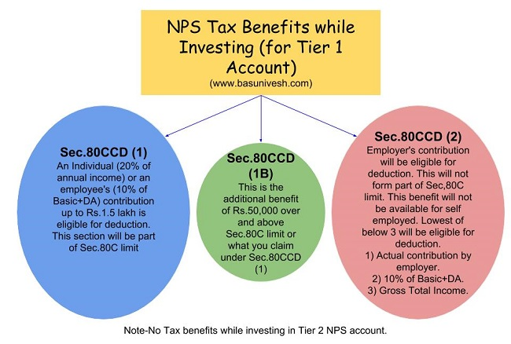
Deductions under Chapter VI-A
NPS Tax Benefit Summary

Slide 41
Deductions under Chapter VI-A
Section 80D
Deduction under this section is available if you satisfy the following conditions.
The taxpayer should be an individual (resident, NRI or Foreign Citizen) or HUF.
Payment should be made out of income chargeable to tax.
Payment should be in NON-CASH mode (for preventive health check up, you can pay either through cash or non-cash mode).
Changes from Budget 2018-
In Budget 2018, the maximum tax deduction limit for senior citizens under Sec.80D is raised to Rs.50,000. The earlier limit was Rs.30,000.
In case of single premium health insurance policies having a cover of more than one year, it is proposed that the deduction shall be allowed on a proportionate basis for the number of years for which health insurance cover is provided, subject to the specified monetary limit.

Slide 42
Deductions under Chapter VI-A
Section 80DD
A resident individual or HUF is allowed to claim the deduction
If incurred an expenditure for medical treatment, training, and rehabilitation of dependent relative (being a person with a disability).
Can be claimed only when deposited or paid for any approved scheme of LIC (or any other insurance) or UTI for the maintenance of such dependent relative.
Fixed deduction of Rs.75,000
Higher deduction of Rs.1,25,000 is available if such dependent relative is suffering from severe disability
NOTE:-dependent means spouse, children, parents, brothers, and sisters, who is wholly and mainly dependent upon the individual.

Slide 43
Deductions under Chapter VI-A
Section 80DDB
An Individual’s of HUFs expenses actually paid for medical treatment of specified diseases and ailments subject to certain conditions can be claimed under this section.
The maximum deduction is Rs. 40,000. This can also be claimed on behalf of the dependents. The tax deduction limit under this section for Senior Citizens and very Senior Citizens (above 80 years) is now revised to to Rs 1,00,000.
With effect from the assessment year 2016-17, the taxpayer shall be required to obtain a prescription from a specialist doctor (not necessarily from a doctor working in a Government hospital) for availing this deduction.
Can claim the deduction for the medical treatment of self, spouse, children, parents brothers, and sisters of the individual.

Slide 44
Deductions under Chapter VI-A
Section 80DDB
The ailments covered under this section are as below:
# Neurological Diseases where the disability level has been certified to be of 40% and above;
(a) Dementia (b) Dystonia Musculorum Deformans (c) Motor Neuron Disease (d) Ataxia (e) Chorea (f) Hemiballismus (g) Aphasia (h) Parkinson’s Disease
# Malignant Cancers
# Full Blown Acquired Immuno-Deficiency Syndrome (AIDS) ;
# Chronic Renal Failure
# Haematological disorders
a) Hemophilia
b) Thalassaemia

Slide 45
Deductions under Chapter VI-A
Section 80E
If the loan is taken by an individual for any study in India or outside India, then they can claim the deduction.
The interest part of the loan on such education loan can be claimed for deduction for pursuing individual’s own education or for the education of his relatives (Spouse, children or any student for whom the individual is legal guardian).
The entire interest is deductible in the year in which the individual starts to pay interest on the loan and subsequent 7 years or until interest is paid in full (i.e for total 8 years).
NOTE:-Interest should be paid out of the income of chargeable to tax.

Slide 46
Deductions under Chapter VI-A
Section 80G
Donations to certain approved funds, trusts, charitable institutions/donations for renovation or repairs of notified temples, etc can be claimed as a deduction under this section.
This deduction can only be claimed when the contribution made by cheque or draft or in cash. In-kind contributions like food material, clothes, medicines etc. do not qualify for deduction under this section.
The donations made to any Political party can be claimed under section 80GGC.
From FY 2017-18, the limit of deduction under section 80G / 80GGC for donations made in cash is reduced from current Rs 10,000 to Rs 2,000 only.

Slide 47
Deductions under Chapter VI-A
Section 80GG
This section only applies to those who have not availed HRA in their salary or not claiming the deduction on their rent in any of the other sections of income
Conditions:
Applicable to Individual or HUF.
Tax Payer may be either salaried or a self-employed. However, must not be getting HRA.
Tax Payer himself or spouse/Minor Child/HUF of which he is a member should not own any accommodation at a place where he is doing a job or business
If Tax Payer owns a house at a place other than the place noted above, then the concession in respect of self-occupied property is not claimed by him [Under Section 23 (2) (a) or 23 (4) (a)].
Tax Payer has to file a declaration in Form No.10BA regarding the expenditure incurred by him towards the payment of rent.

Slide 48
Deductions under Chapter VI-A
Section 80GG
How much amount of deduction one can avail under Sec. 80GG?
If the all five conditions are satisfied, the amount deductible under Section 80GG is LEAST OF THE FOLLOWING.
Rs.5, 000 per month;
25% of total income of taxpayer for the year; or
Rent Paid less 10% of total income (Rent Paid-10% of Total Income).

Slide 49
Deductions under Chapter VI-A
Section 80GG
Example:
What is total income for the purpose of Sec. 80GG?
We can calculate it as below.
Total Income=Gross Total Income-LTCG-STCG-Income referred under the Sec.115A-Amount deductible under Sec.80C to 80U (except Section 80GG)
Mr. X’s total income (calculated as per above formula) is Rs.4, 00,000. He pays an annual rent of Rs.1, 50,000. Then least of the below will be applicable for deduction under Sec. 80GG.
Rs.60, 000 per year.
Rent Paid-10% of Total Income=Rs.1,50,000-Rs.40,000=Rs.1,10,000’-.
25% of Total Income i.e. Rs.1, 00,000/-.
So least of the above will be Rs.60, 000/-, which one can claim under Section 80GG for that particular FY.

Slide 50
Deductions under Chapter VI-A
Section 80U
To claim tax benefits under Sec.80U, the taxpayer should be an individual and resident of India.
If he is suffering from 40% or more than 40% of any disability, then he can claim a tax deduction.
You can claim the fixed deduction of Rs.75,000. a higher deduction of Rs.1,25,000 is allowed in respect of a person with a severe disability (i.e. having a disability of 80% or above).

Slide 51
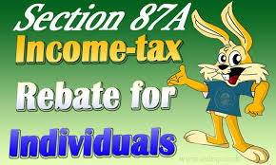
Rebate under Section 87A
The tax rebate of Rs.2,500 for individuals with income of up to Rs 3.5 Lakh has been proposed in Budget 2017-18.
To avail this benefit, there are certain conditions and they are as below.
The taxpayer must be a resident individual.
Your Total Income (Less Deductions from 80C to 80U) is equal to or less than Rs.3,50,000.
The rebate is the 100% of income tax on such income or Rs.2,500 (whichever is less).

Slide 52
Rebate under Section 87A
The tax rebate of Rs.2,500 for individuals with income of up to Rs 3.5 Lakh has been proposed in Budget 2017-18.
To avail this benefit, there are certain conditions and they are as below.
The taxpayer must be a resident individual.
Your Total Income (Less Deductions from 80C to 80U) is equal to or less than Rs.3,50,000.
The rebate is the 100% of income tax on such income or Rs.2,500 (whichever is less).

Slide 53
Rebate under Section 87A
The tax rebate of Rs.2,500 for individuals with income of up to Rs 3.5 Lakh has been proposed in Budget 2017-18.
To avail this benefit, there are certain conditions and they are as below.
The taxpayer must be a resident individual.
Your Total Income (Less Deductions from 80C to 80U) is equal to or less than Rs.3,50,000.
The rebate is the 100% of income tax on such income or Rs.2,500 (whichever is less).

Slide 54
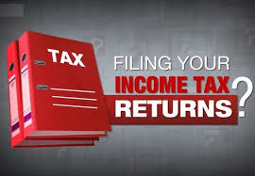
Income Tax E-Filing ( ITR-1)
Total ITRs are – ITR 1 to ITR 7
ITR-1
Earlier ITR-1 was applicable for both Residents, Residents Not ordinarily resident (RNOR) and also Non-residents. Now, this form has been made applicable only for resident individuals.
The condition of the individual having income from salaries, one house property, other income and having total income up to Rs 50 lakhs continues.
There is a requirement to furnish a break-up of salary. Until now, these details would appear only in Form 16 and the requirement to disclose them in the return had never arisen.
There is also a requirement to furnish a break up of Income under House Property which was earlier mandatory only for ITR -2 and other forms.

Slide 55
Clubbing Provisions
According to the stipulations of the Income Tax Act, a person has to pay taxes on all taxable income earned during a financial year.
At the time of computing the Gross Total Income, if the income of any other person in a family is included, then the inclusion is called ‘Clubbing of Income’.
Section 64 of the Income Tax Act, 1961 deals with clubbing of income. Clubbing of income ensures that taxpayers do not circumvent their tax liability by transferring their incomes and assets within the family.

Slide 56
Clubbing Provisions
As per the Income Tax Act, every person has to pay taxes on the taxable income earned. No person is allowed to divert his income to any relatives to reduce tax liability. Clubbing of income means an income of other person is included in the taxpayer’s total income while computing income tax payable.
Many taxpayers in India have attempted to reduce their income tax liability by transferring their incomes and assets to their family members, in such a way that most of the income falls under the taxable amount. The clubbing of income regulations ensures that such practices are curbed

Slide 57
Clubbing Provisions
Clubbing of income is needed under the following circumstance:
Investing money in the form of a fixed deposit in children name.
Earning assets in the name of relatives (wife or child).
Creating saving bank accounts for dependants.
Mutual funds for the child.
Shares in the name of spouse/child.
Post office savings for family members.
Also, if a taxpayer transfers the ownership of an asset and the income from the asset to a dependant, it will be continued to be added to the taxpayer’s income under the clubbing of income provisions.
Example: If a person is purchasing a flat in the name of a family member and the other person let out this flat on rent, the rental income earned by the person in name of the family member is taxable. As per section 64 of Income Tax, the income would be clubbed with person purchasing the flat.

Slide 58
Set Off and Carry Forward of Losses
Profit and losses are two sides of a coin. Losses, of course, are hard to digest. However, the Income-tax law in India does provide taxpayers some benefits of incurring losses too. The law contains provisions for set-off and carry forward of losses.
Set off of losses
Set off of losses means adjusting the losses against the profit or income of that particular year. Losses that are not set off against income in the same year can be carried forward to the subsequent years for set off against income of those years. A set-off could be an intra-head set-off or an inter-head set-off.

Slide 59
Set Off and Carry Forward of Losses
Intra-head Set Off
The losses from one source of income can be set off against income from another source under the same head of income.
For eg: Loss from Business A can be set off against profit from Business B, where Business A is one source and Business B is another source and the common head of income is “Business”.
Exceptions to an intra-head set off:
Losses from a Speculative business will only be set off against the profit of the speculative business. One cannot adjust the losses of speculative business with the income from any other business or profession.
Loss from an activity of owning and maintaining race-horses will be set off only against the profit from an activity of owning and maintaining race-horses.
Long-term capital loss will only be adjusted towards long-term capital gains. However, a short-term capital loss can be set off against both long-term capital gains and short-term capital gain.
Losses from a specified business will be set off only against profit of specified businesses. But the losses from any other businesses or profession can be set off against profits from the specified businesses.

Slide 60
Set Off and Carry Forward of Losses
Inter-head Set Off
After the intra-head adjustments, the taxpayers can set off remaining losses against income from other heads.
Eg. Loss from house property can be set off against salary income.
Instances of an inter-head set off of losses:
Loss from House property can be set off against income under any head
Business loss other than speculative business can be set off against any head of income except income from salary.
One needs to also note that the following losses can’t be set off against any other head of income:
Speculative Business loss
Specified business loss
Capital Losses
Losses from an activity of owning and maintaining race-horses

Slide 61
Set Off and Carry Forward of Losses
Carry forward of losses
After making the appropriate and permissible intra-head and inter-head adjustments, there could still be unadjusted losses. These unadjusted losses can be carried forward to future years for adjustments against income of these years. The rules as regards carry forward differ slightly for different heads of income
Losses from House Property :
Can be carry forward up to next 8 assessment years from the assessment year in which the loss was incurred
Can be adjusted only against Income from house property
Can be carried forward even if the return of income for the loss year is belatedly filed.

Slide 62
Set Off and Carry Forward of Losses
Carry forward of losses
After making the appropriate and permissible intra-head and inter-head adjustments, there could still be unadjusted losses. These unadjusted losses can be carried forward to future years for adjustments against income of these years. The rules as regards carry forward differ slightly for different heads of income
Losses from Non-speculative Business (Regular Business) Loss
Can be carry forward up to next 8 assessment years from the assessment year in which the loss was incurred
Can be adjusted only against Income from business or profession
Not necessary to continue the business at the time of set off in future years
Cannot be carried forward if the return is not filed within the original due date.

Slide 63
Set Off and Carry Forward of Losses
Carry forward of losses
After making the appropriate and permissible intra-head and inter-head adjustments, there could still be unadjusted losses. These unadjusted losses can be carried forward to future years for adjustments against income of these years. The rules as regards carry forward differ slightly for different heads of income
Speculative Business Loss:
Can be carry forward up to next 4 assessment years from the assessment year in which the loss was incurred
Can be adjusted only against Income from speculative business
Cannot be carried forward if the return is not filed within the original due date.
Not necessary to continue the business at the time of set off in future years

Slide 64
Set Off and Carry Forward of Losses
Carry forward of losses
After making the appropriate and permissible intra-head and inter-head adjustments, there could still be unadjusted losses. These unadjusted losses can be carried forward to future years for adjustments against income of these years. The rules as regards carry forward differ slightly for different heads of income
Capital Losses:
Can be carry forward up to next 8 assessment years from the assessment year in which the loss was incurred
Long-term capital losses can be adjusted only against long-term capital gains.
Short-term capital losses can be set off against long-term capital gains as well as short-term capital gains
Cannot be carried forward if the return is not filed within the original due date

Slide 65
TDS (TAX DEDUCTED AT SOURCE)
The concept of TDS was introduced with an aim to collect tax from the very source of income. As per this concept, a person (deductor) who is liable to make payment of specified nature to any other person (deductee) shall deduct tax at source and remit the same into the account of the Central Government.
The deductee from whose income tax has been deducted at source would be entitled to get credit of the amount so deducted on the basis of Form 26AS or TDS certificate issued by the deductor.
Rates for deduct of tax at source
Taxes shall be deducted at the rates specified in the relevant provisions of the Act or the First Schedule to the Finance Act.
TDS Rates

Slide 66
TDS (TAX DEDUCTED AT SOURCE)
How to pay Tax Deducted/Collected at source?
Tax deducted or collected at source shall be deposited to the credit of the Central Government by following modes:
1) Electronic mode: E-Payment is mandatory for
a) All corporate assesses; and
b) All assesses (other than company) to whom provisions of section 44AB of the Income Tax Act, 1961 are applicable.
2) Physical Mode: By furnishing the Challan 281 in the authorized bank branch

Slide 67
TCS (TAX COLLECTION AT SOURCE)
Tax Collected at Source (TCS) is a tax payable by a seller which he collects from the buyer at the time of sale of goods. Section 206 of the Income Tax Act mentions the list of goods on which the seller should collect tax from buyers.
Who is a Seller for TCS?
A seller is categorized as any individual or organization authorized under Tax Collected at Source. The following are defined as Sellers –
1. Central Government 2. State Government
3. Statutory Corporation or Authority 4. Local Authority
5. Company 6. Co-operative Society
7. Partnership Firms 8. Any Individual or Hindu Undivided Family (HUF) defined under the Section 44AB, who has gross receipts or total sales that exceed the specified financial restricts based on the previous year
TCS

Slide 68
TCS (TAX COLLECTION AT SOURCE)
Tax Collected at Source (TCS) is a tax payable by a seller which he collects from the buyer at the time of sale of goods. Section 206 of the Income Tax Act mentions the list of goods on which the seller should collect tax from buyers.
Who is a Buyer for TCS?
A buyer is categorsied as any individual, who receives the actual goods or the rights of receiving goods at a tender, auction, sale, or other modes. All individuals (except for the below – mentioned list of individuals and organizations) are classified as buyers for TCS –
1. Public Sector Entities
2. Central Government
3. State Government
4. Consulates and any other Trade Representations of a Foreign Nation
5. High Commission Embassies
6. Clubs such as social clubs or sports clubs

Slide 69
TCS (TAX COLLECTION AT SOURCE)
What Goods & Transactions Covered under TCS Provisions?
The following goods and/or transactions are considered for Tax Collected at Source –
1. Liquors of alcoholic nature including IMFL (Indian Made Foreign Liquor) that are deemed for human consumption
2. Timber wood obtained from a leased forest area
3. Tendu Leaves
4. Timber wood obtained from any mode other than leased
5. Forest produces (other than timber and Tendu leaves)
6. Scrap
7. Parking lot tickets, Toll Plaza, Mining and Quarrying
8. Minerals that include iron ore, lignite or coal
9. Bullion having valuation over Rs. 2 lakh
10. Jewellery whose value exceeds Rs. Five lakhs
11. Motor vehicle purchases over Rs. 10 Lakhs

Slide 70
Advance Tax Administrative Procedures
Advance tax is the amount of income tax that is paid much in advance rather than a lump-sum payment at the year-end. Also known as earn tax, advance tax is to be paid in installments as per the due dates decided by the income tax department.
Why is advance tax important?
Advance tax is the income tax paid in advance for the income earned in a particular financial year. Usually, the tax is to be paid when the income is earned. Still, under the tax provisions of advance tax, the payer has to estimate the income for the entire year. And based on this estimate the tax is paid at specific time intervals. Here it is important that the tax payer estimates the income and then calculates the estimated tax on it to check whether he or she needs to pay the advance tax and how much.

Slide 71
Advance Tax Administrative Procedures
Who should pay advance tax?
As per section 208 of the Income Tax Act 1961, every person whose estimated tax liability for the year is more than or equal to `10,000 is liable to pay advance tax.
Those who are excluded from paying advance tax are senior citizens who are above the age of 60, not having any income from business or profession.
What are the important dates in advance tax?
Advance tax varies with the due dates. The advance tax to be paid by an individual, as well as corporate assessees, are as follows:
Sr | Due Date | Advance Tax Payable
1. | On or before 15th June | 15%
2. | On or before 15th September | 45%
3. | On or before 15th December | 75%
4. | On or before 15th March | 100%
Advance Tax

Slide 72
ICDS (Income Computation and Disclosure Standards):
Income Computation and Disclosure Standards (ICDS) are guidelines using which taxpayers and the Income Tax Department can calculate the taxable income obtained by an assessee in a financial year.
The ICDS were framed by the Government of India with the objective of inculcating uniformity in accounting policies.
The purpose of the ICDS is to govern the computation of income in accordance with the pertinent tax provisions. ICDS has been framed using Generally Accepted Accounting Principles (GAAPs ) with the assistance of the Institute of Chartered Accountants of India (ICAI). It has been in existence from the financial year of 2015-16. In this article, we discuss the various provisions of ICDS.

Slide 73
Features of ICDS
ICDS is not meant for maintenance of books of account, but for the computation of income.
Non-compliance to the standards may place the authority in a position of assessing the income on ‘best judgment’ basis.
ICDS doesn’t have any criterion of income or turnover.
Every ICDS, except on securities, provide for transitional provisions to facilitate first-time adoption and consideration of the resultant impact.
In the event of a conflict between the provisions of the Act and ICDS, the provisions of the Act will be given preference ahead of the latter.
ICDS does not have prudence as a fundamental assumption except if it is specifically stated so in the respective ICDS. It may lead to earlier recognition of income or gains or later recognition of expenses in comparison with the Accounts formulated under the existing Accounting Standards (AS).
The Income Tax Act allows the Assessing Officer to conduct an assessment in accordance with Section 144 on the event of a failure to compute income according to ICDS.
Form 3CD has been revised for making mandatory disclosures in compliance with ICDS.

